Slide 1
Digital Pet Task App
By: Laura Lopez, Sarah Jorissen, Jonathan Hoffman

Slide 2
Now known as . . .
Fur-minder

Slide 3
Changes and Deviations: Task List
Requirement 1.1.1.3 - tasks will no longer ask for a time slot
Affects requirements 2.3.1.1.3 and 2.4.1.1.3 as time slots will no longer be edited in edit task window
Also affects pet deterioration
Requirement 1.1.4.3 - no custom reminders
Addition of no reminder selection

Slide 4
Task List Accomplishments
The modals for the task list have been nearly completed.
Add button for task creation
Asks for user input: name, description, date range, repetition
Cancel button already completed that closes out of the form upon selection
Save button that is displayed on the form but has not had functionality added to it as the tasks can not yet be saved onto a database.
Needs to be done:
Save button functionality/database
Modal to access calendar from task list
Have tasks appear on task list

Slide 5

Task List Initialization

Slide 6
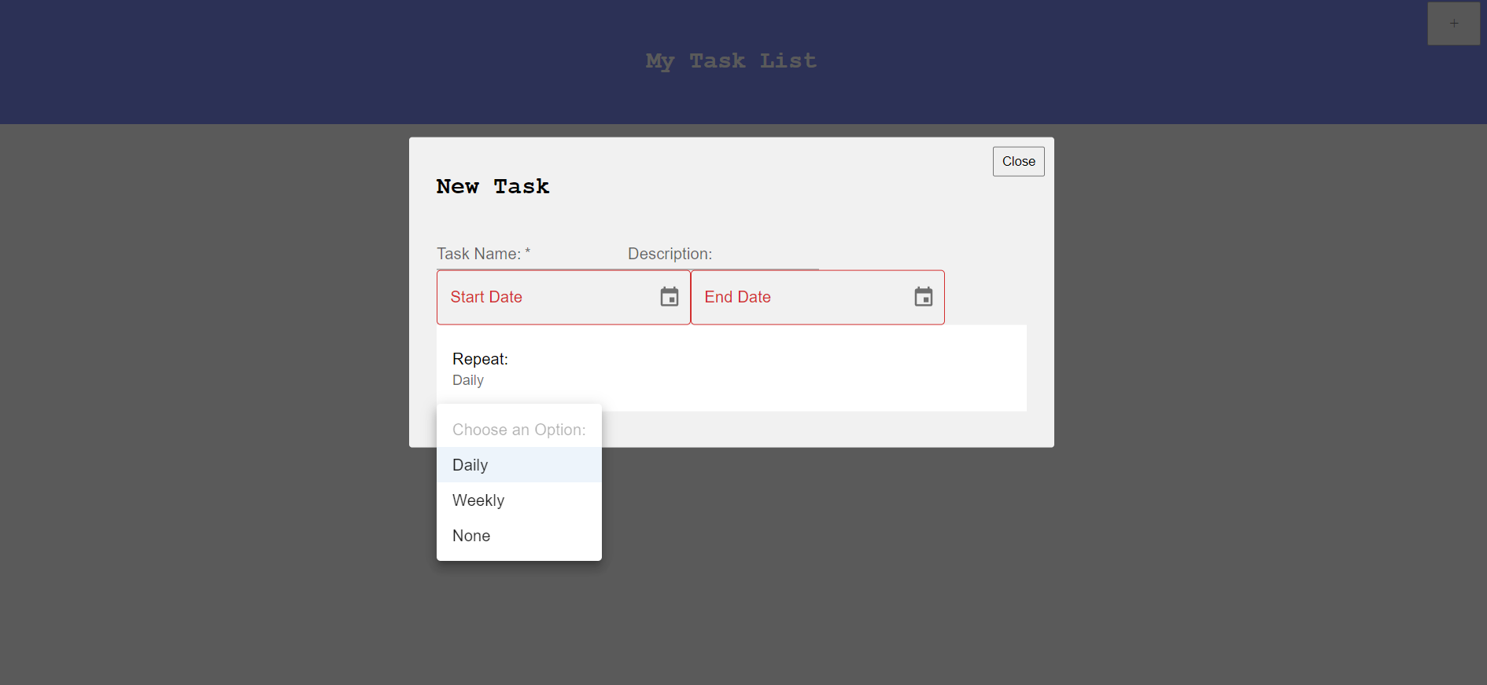
Adding Tasks

Slide 7
Changes and Deviations: Calendar
Requirement 2.1.2 will not be implemented due to the calendar implementation.
Calendar was developed as a modal
Requirement 2.2.2, we have deviated from this requirement
The User will be able to see the tasks for the day automatically instead of having a task list generate
We also implemented a task list view on the calendar
Requirement 2.2.3 may change, but is also not yet implemented
Adding tasks have been implemented, editing the task has not.
Requirement 2.3/2.4 will most likely change due to time constraints

Slide 8
Calendar Accomplishments
The calendar component has been successively implemented as a modal, ready for implementation on main page
Calendar’s different views have been implemented and are functional
“Weekly” View: This shows a calendar based on the week
“Monthly” View: This shows a calendar based on the month
“List” View: This shows all tasks that are on the calendar in a list format
A “Today” option: That takes the user to the current date
A “Prev” and “Next” option: That takes the user forward and backward through dates
The calendar can add tasks to a date when click after asking for a Title, and Description in an alert box
The calendar can delete tasks when a task is clicked on.
Needs to be done:
Being able to connect to the database for task info

Slide 9
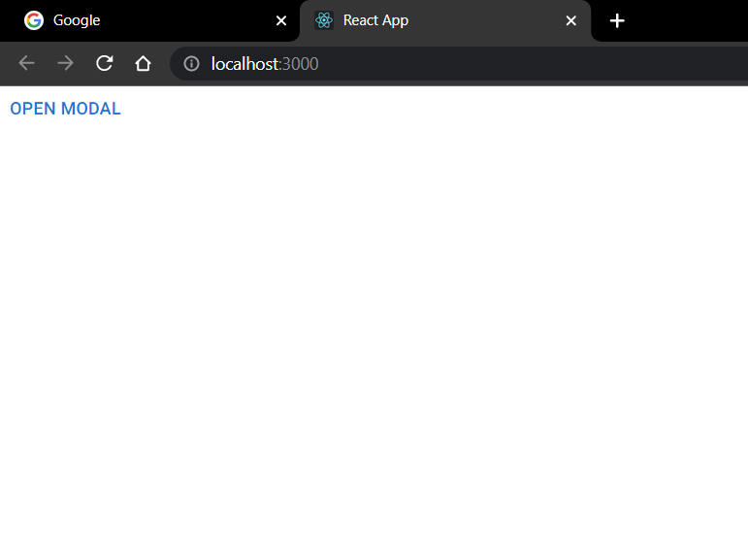
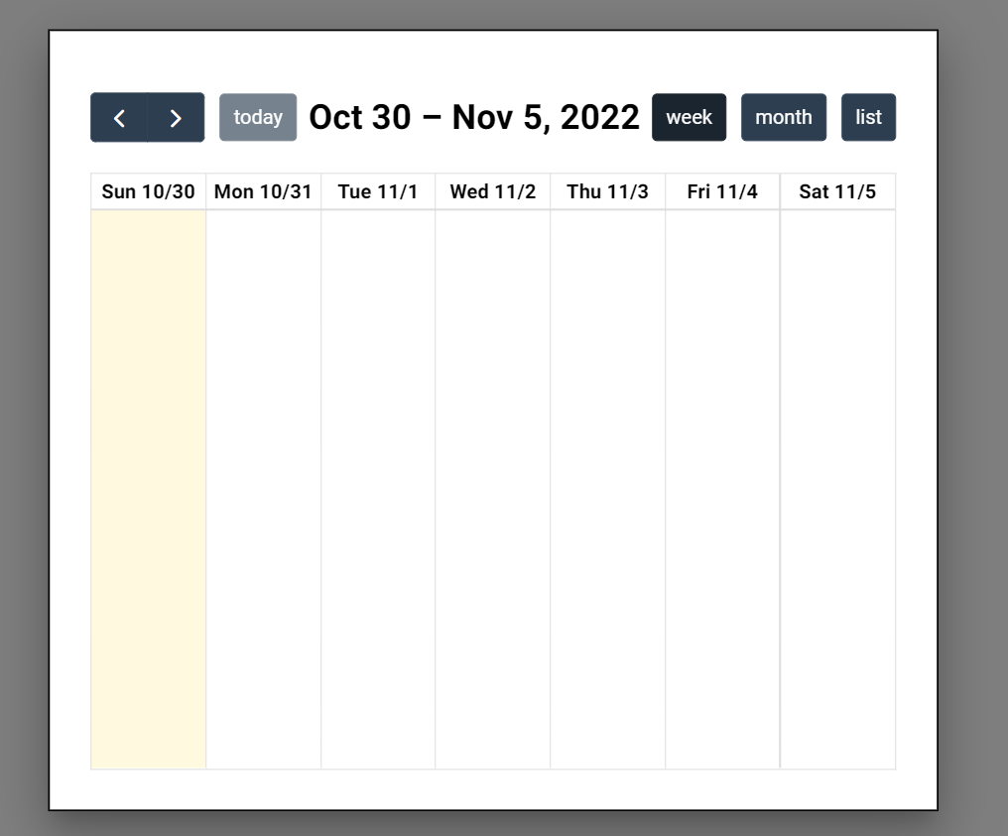
Calendar Modal:

Slide 10
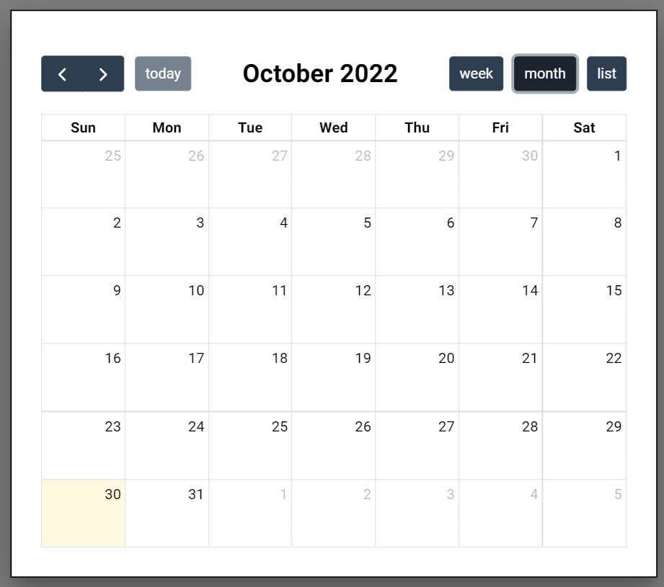
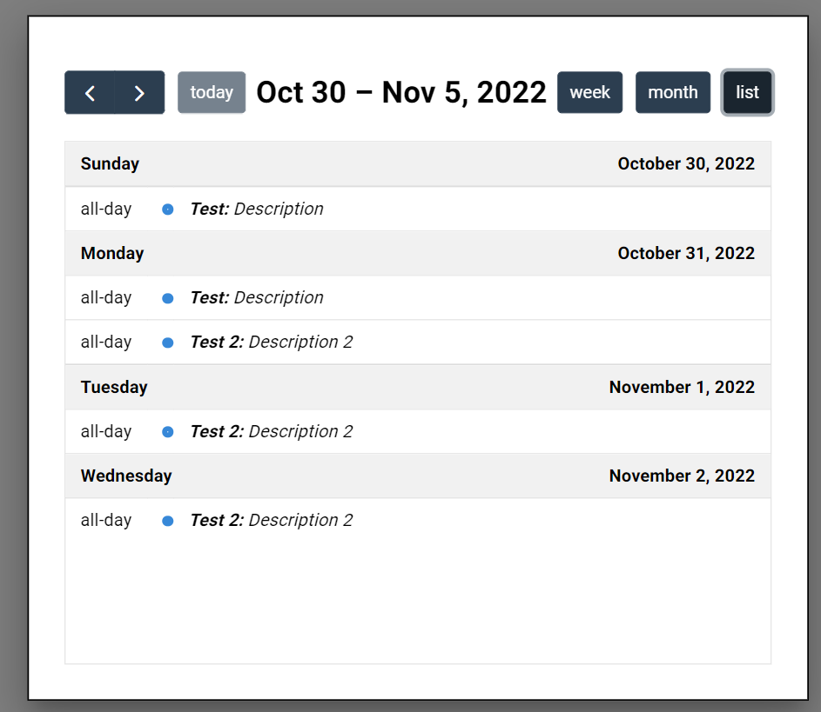
Calendar Views:

Slide 11
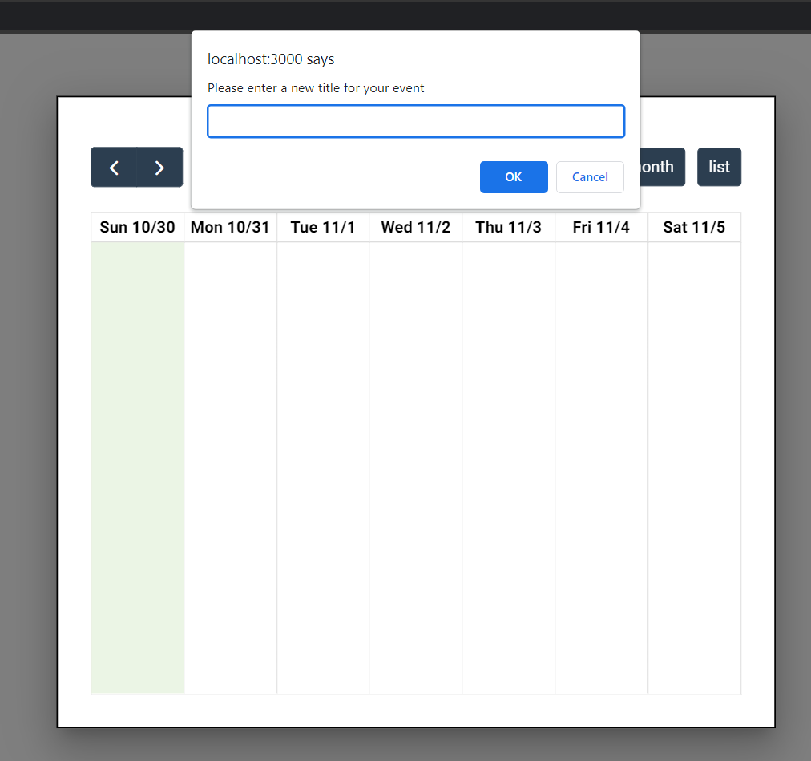
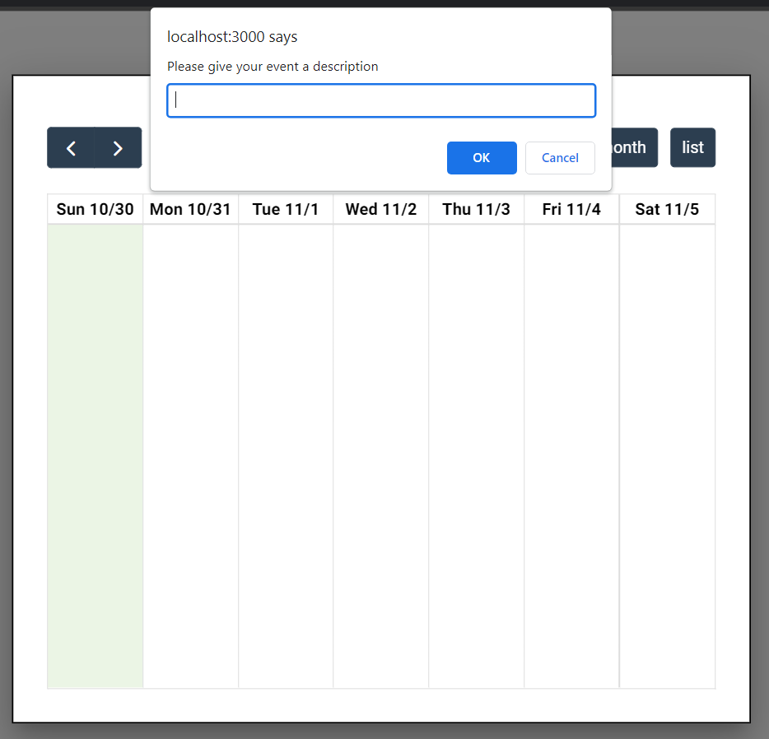
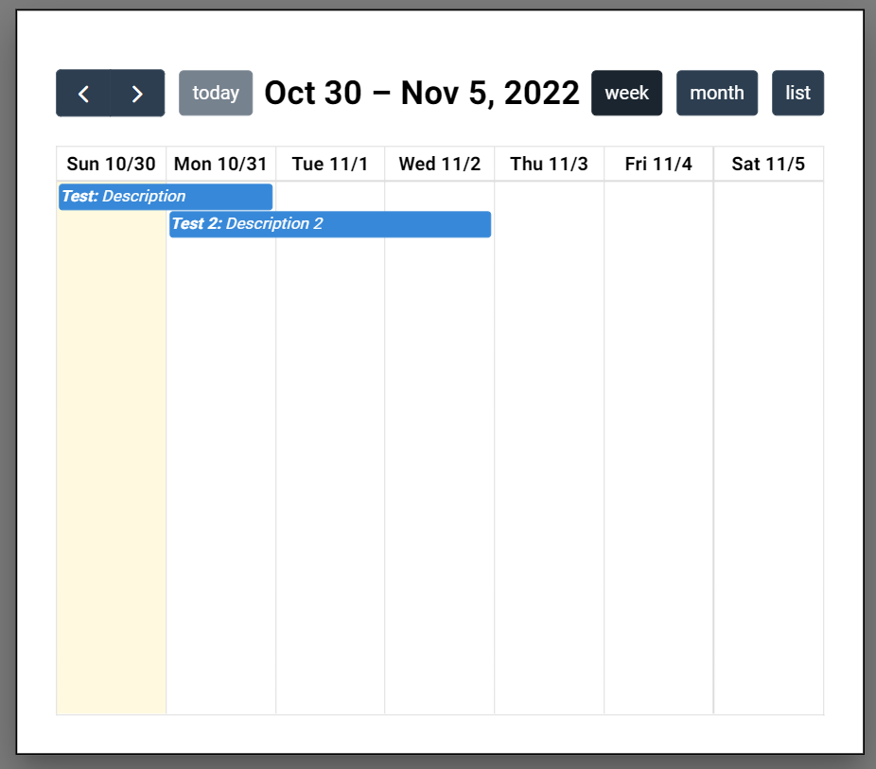
Calendar adding tasks:

Slide 12
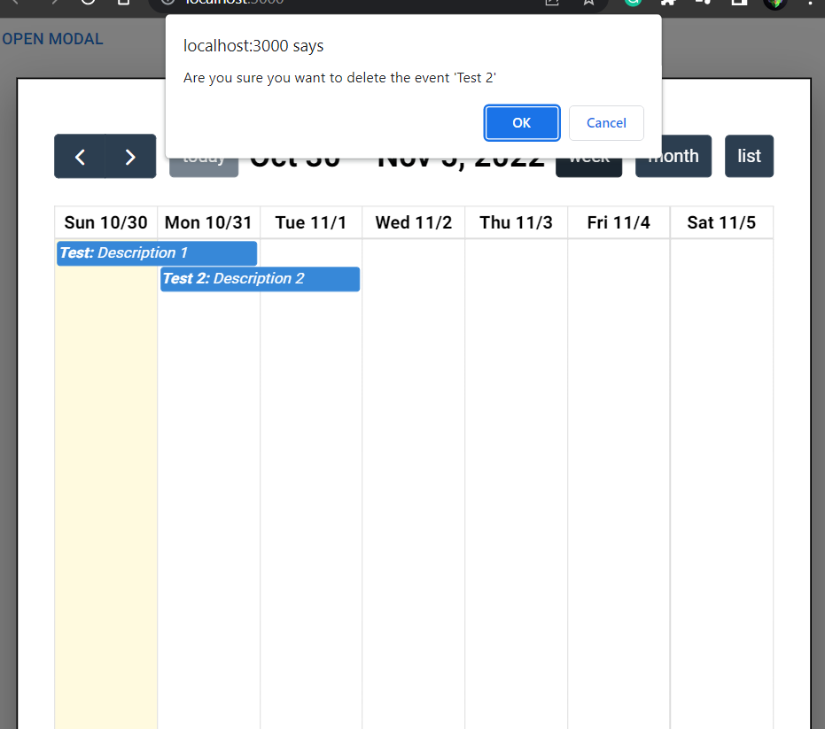
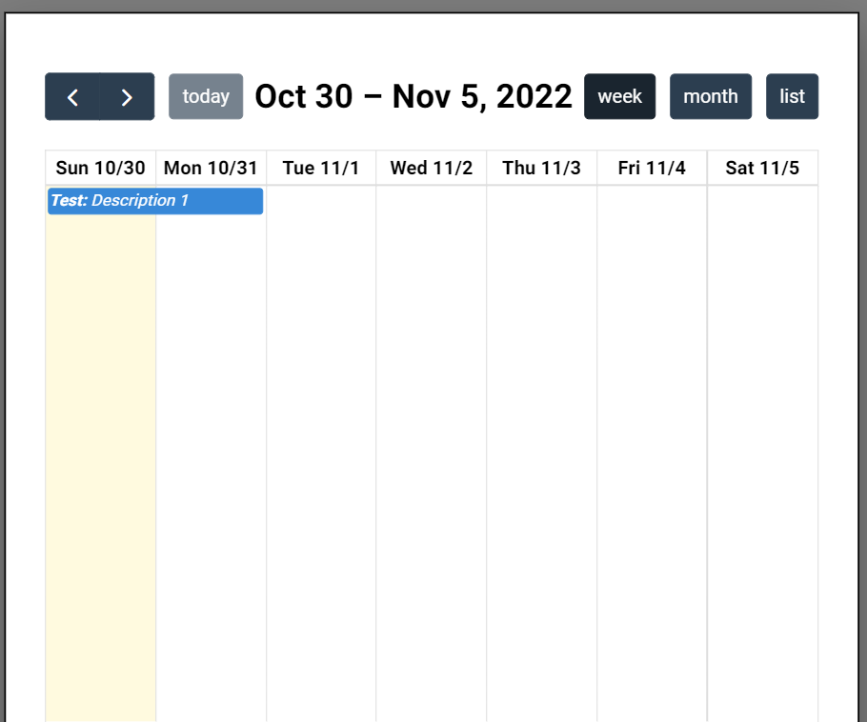
Calendar deleting tasks:

Slide 13
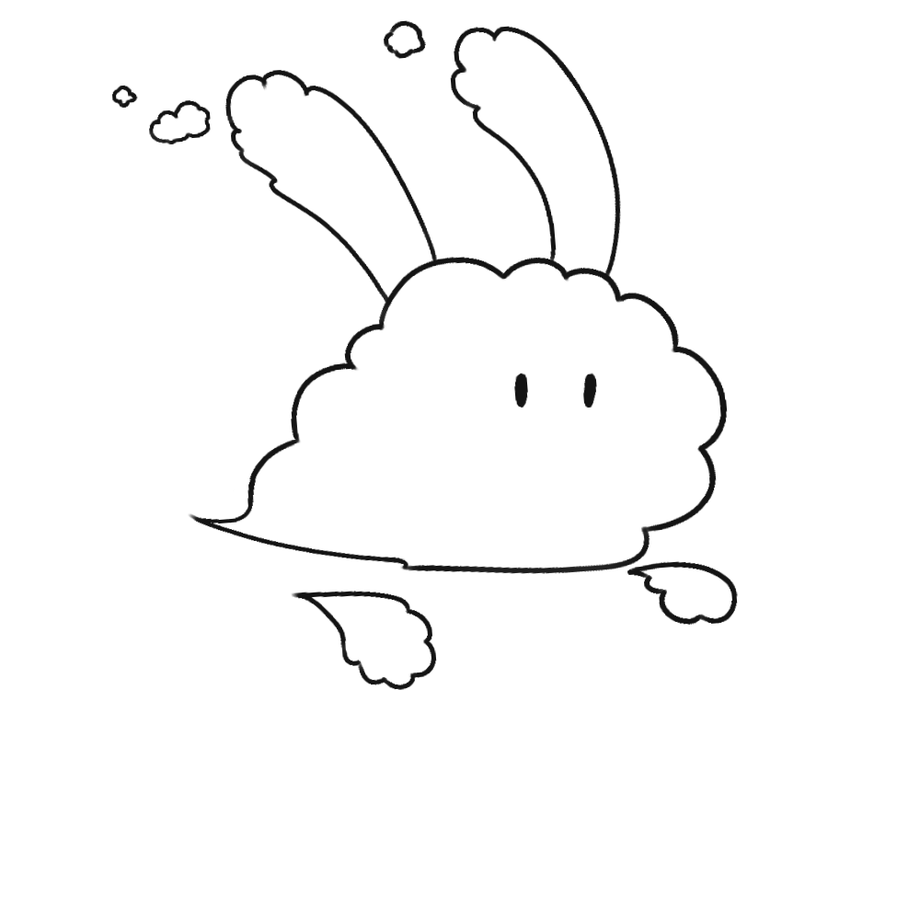
Changes and Deviations: Pet
3.1.2.1: Pet’s name can be changed in customization menu
3.2.1.1: A dedicated function will check the current date to see if pet status needs to be updated
A dedicated variable will be set to the next date if pet has been updated
Current date is checked with this variable to see if changes need to be made

Slide 14
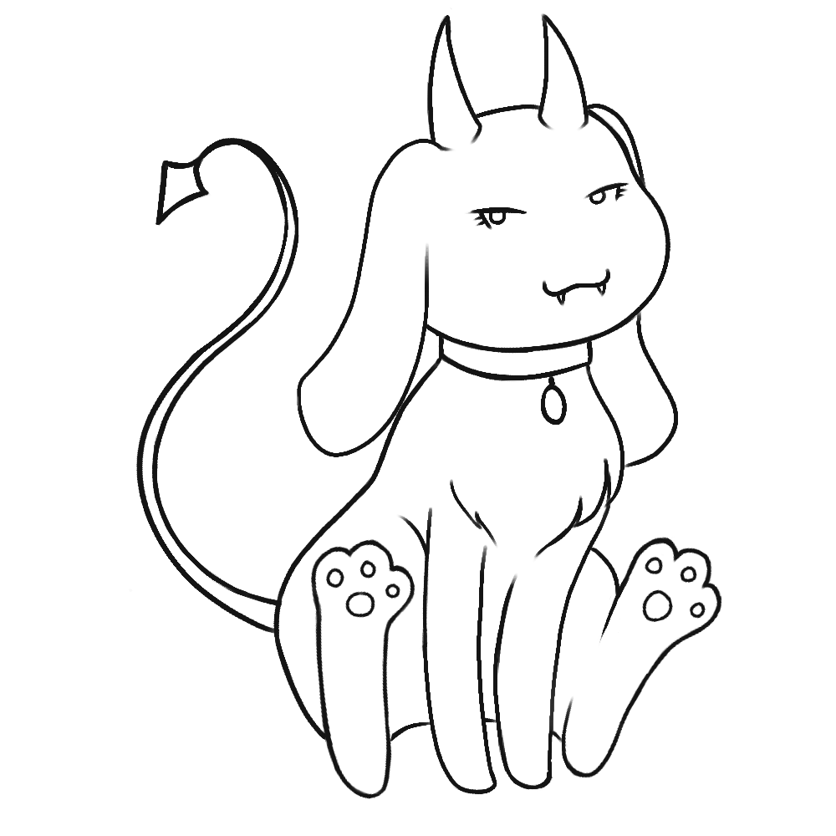
Pet Accomplishments
Requirement 3.1 (Pet View) updates:
Designs for pets have been finalized
All “adult” pets have been drawn

Slide 15

To Be Implemented: Pet
Requirement 3.2: Finish cleaning up all drawings & animation sheets
3.2.1: Update pet display based on status & age
Requirement 3.3: Finalize & clean up accessories for pet
Implement pet customization menu & update pet with changes

